Slide 1
Image Segmentation
Progress Report
Bishal

Slide 2

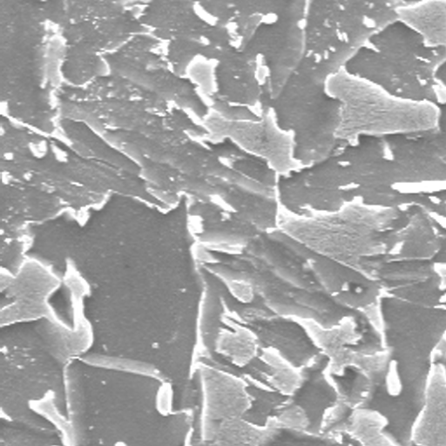
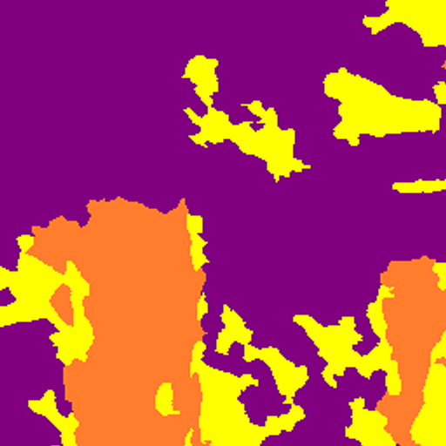
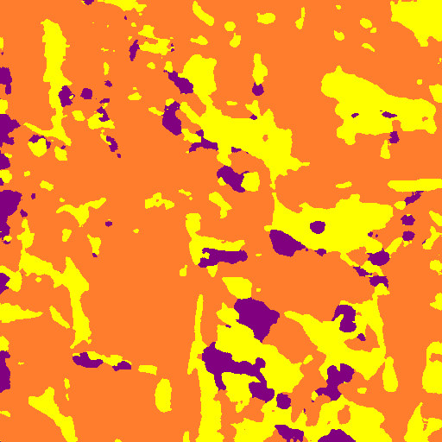
Model Output
Input Test Image
Input Label Image
Output Test Image
Validation mIOU → 0.44993199142250484
Validation Acc → 91.942
Dice Coefficient(Validation) → 0.8195625888211245
Dice Coefficient(Test) → 0.6842116581391179

Slide 3
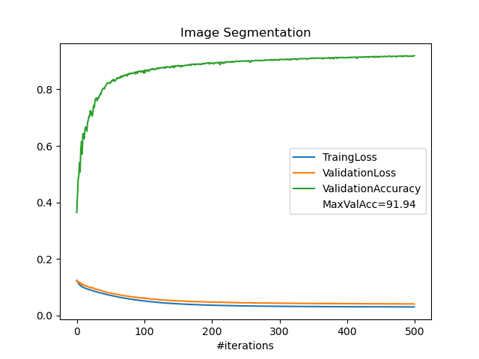
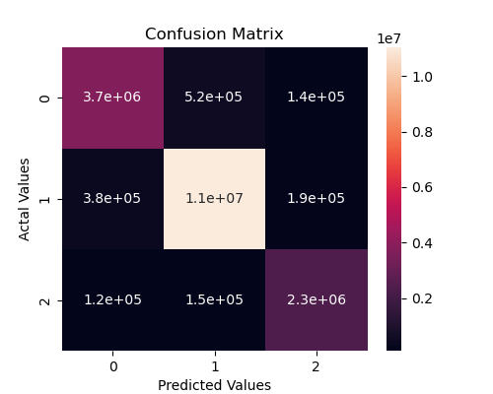
Model Metrics
Confusion Matrix
[[ 3737951. 522021. 135981.]
[ 382343. 11028152. 186354.]
[ 121146. 151955. 2346321.]]

Slide 4
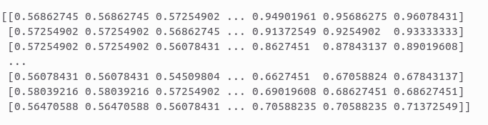
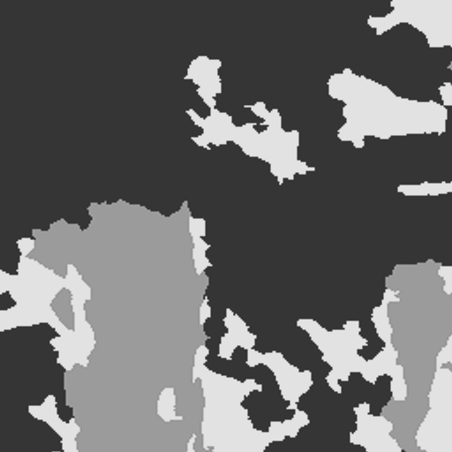
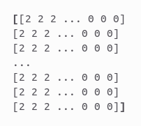
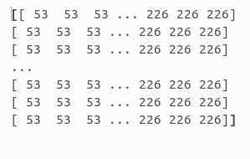
Model Outlook
Image And Label
Augmented part of the Image
M
O
D
E
L
Formatted into corresponding classes of
[0, 1, 2]
Ideal case
Converted into
Gray-scale
But the observed
formatting of some images turned out to be like this
→
random image

Slide 5
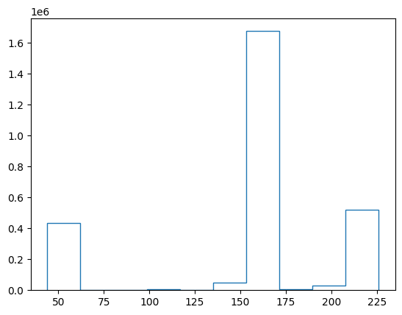
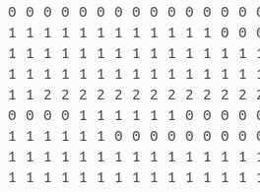
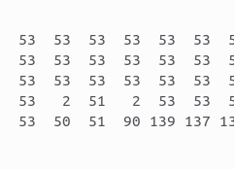
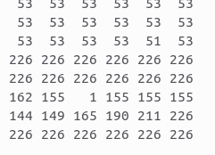
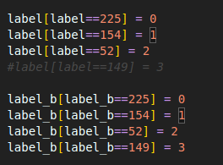
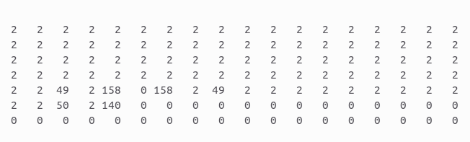
Closer Inspection
Image 14
Image 294
Image 697
Gray-scale Pixel Distribution
LM 0 → The Code tried to convert specific pixel values to be set to [0, 1, 2] under a given condition.
But in reality such pixel values were not consistent in images.
LM 1→ I tried to set a buffer of 3 pixels and
the conversion was more consistent and with few outliers.
Existing Corresponding code
Image 381

Slide 6
LM0 vs LM1
Comparative Output Results between LM0 and LM1 after 1 iteration
Existing code
Modified code
LM 1→Val Accuracy = 64.23%
Time per epoch = 1m 57s
LM 0→Val Accuracy = 36.41%
Time per epoch = 1m 48s
LM 1→Val Accuracy = 64.23%
Time per epoch = 1m 57s
With 태호's help, we thought of another approach (LM2) of removing color interpolation that could improve the results. And if implemented at the time of image augmentation could improve the running time of the model.
Will run the model after some modifications and give the result as soon as possible.

